Slide 1

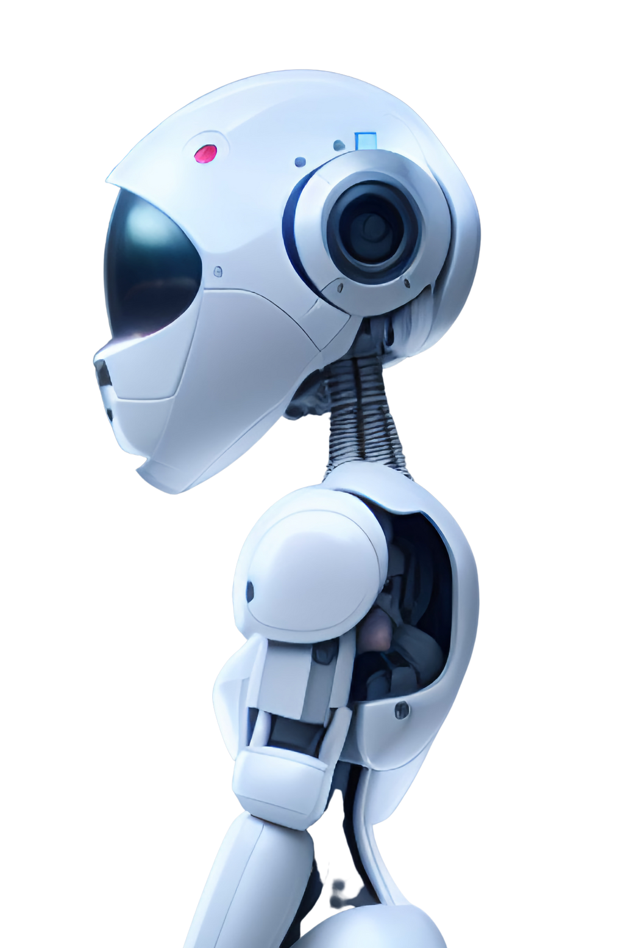

TRENDS AND RESEARCH DEVELOPMENTS OF
BIOSENSORS
S T JAYAPRAKASH

Slide 2
TABLE OF CONTENTS
Introduction
TRENDS
RESEARCH
AI in BIOSENSORS
FUTURE OF BIOSENSORS
R&D and Achievements
Conclusion
01
02
03
04
05
06
07

Slide 3
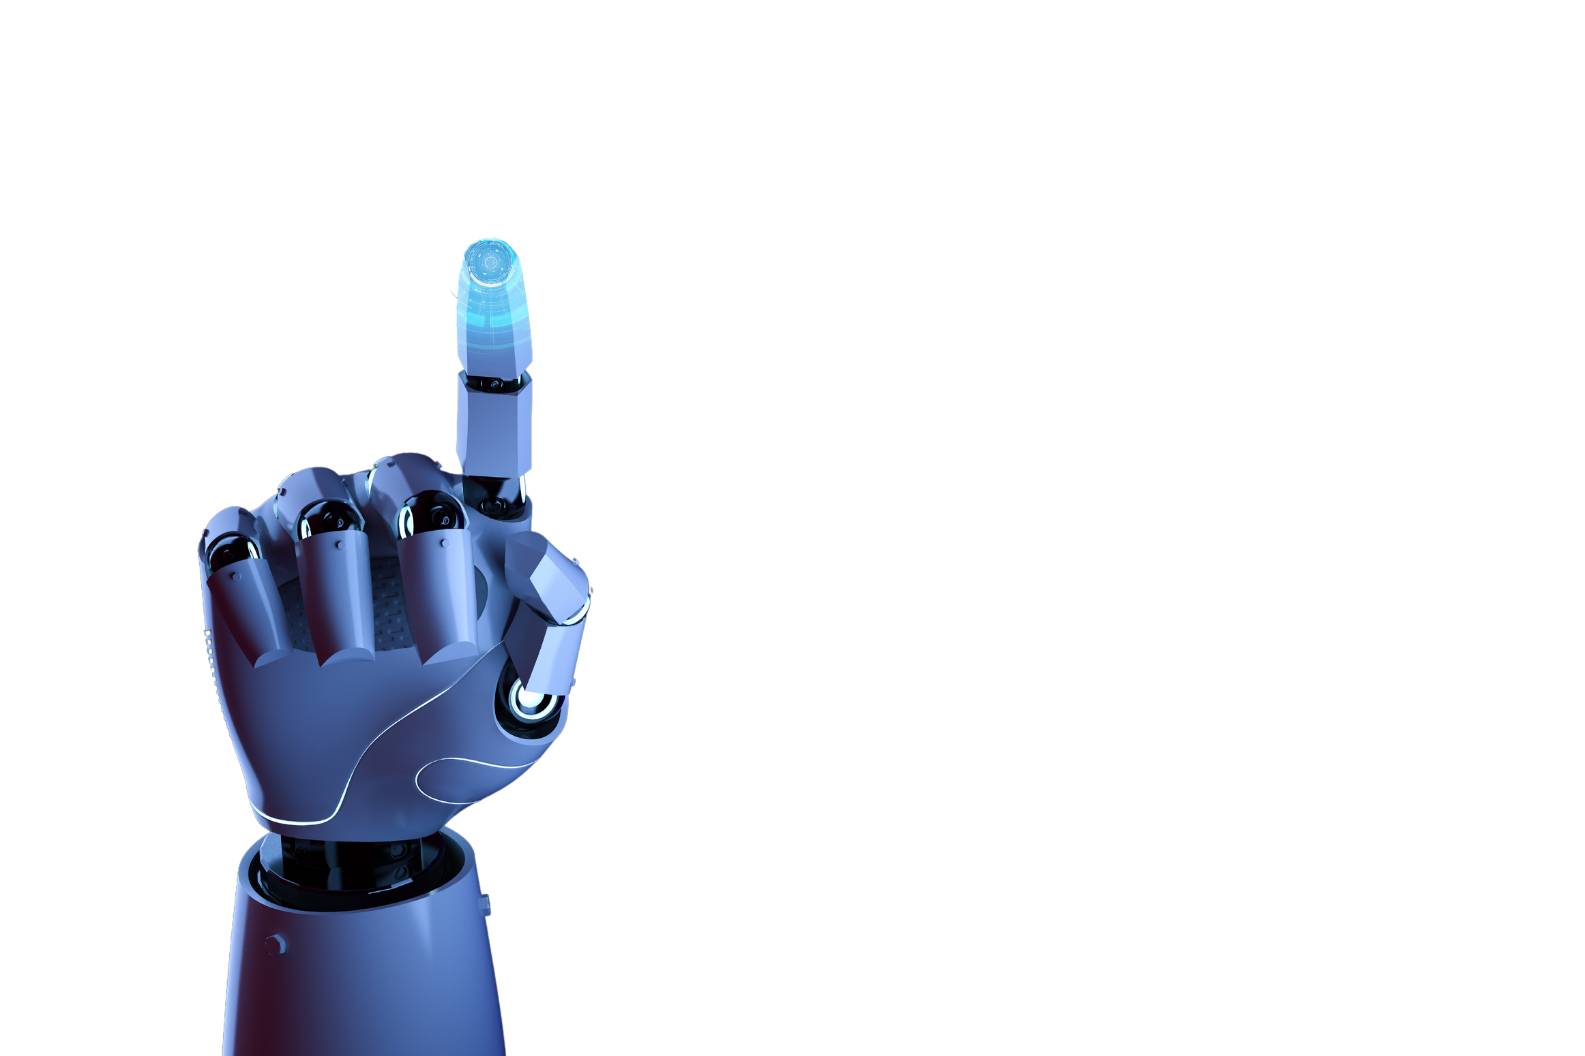
INTRODUCTION
BIOSENSORS, BIONANOSENSORS, & AI: AN INTEGRATIVE OVERVIEW
Biosensors represent a revolutionary intersection of biology, electronics, and data science, enabling real-time detection and analysis of biological parameters. These sophisticated devices combine biological recognition elements with advanced transduction mechanisms to convert molecular interactions into measurable electrical or optical signals.
BIO NANO SENSORS: MINIATURIZATION AND ENHANCED SENSITIVITY
Bio nano sensors leverage nanotechnology to dramatically improve sensing capabilities:
Nanoscale materials (graphene, carbon nanotubes)
Enhanced sensitivity at molecular levels
Reduced sample requirements
Faster response times
Potential for single-molecule detection
AI INTEGRATION IN BIOSENSING
Data Processing
Adaptive Learning
Advanced Applications
Emerging Technological Convergence

Slide 4
INTRODUCTION
FUTURE RESEARCH DIRECTIONS
Quantum sensing technologies
Neuromorphic computing integration
Advanced material engineering
Miniaturized implantable devices
Multi-parametric sensing platforms
Global R&D centers are converging technological domains to revolutionize biosensing capabilities across scientific and industrial applications.

Slide 5
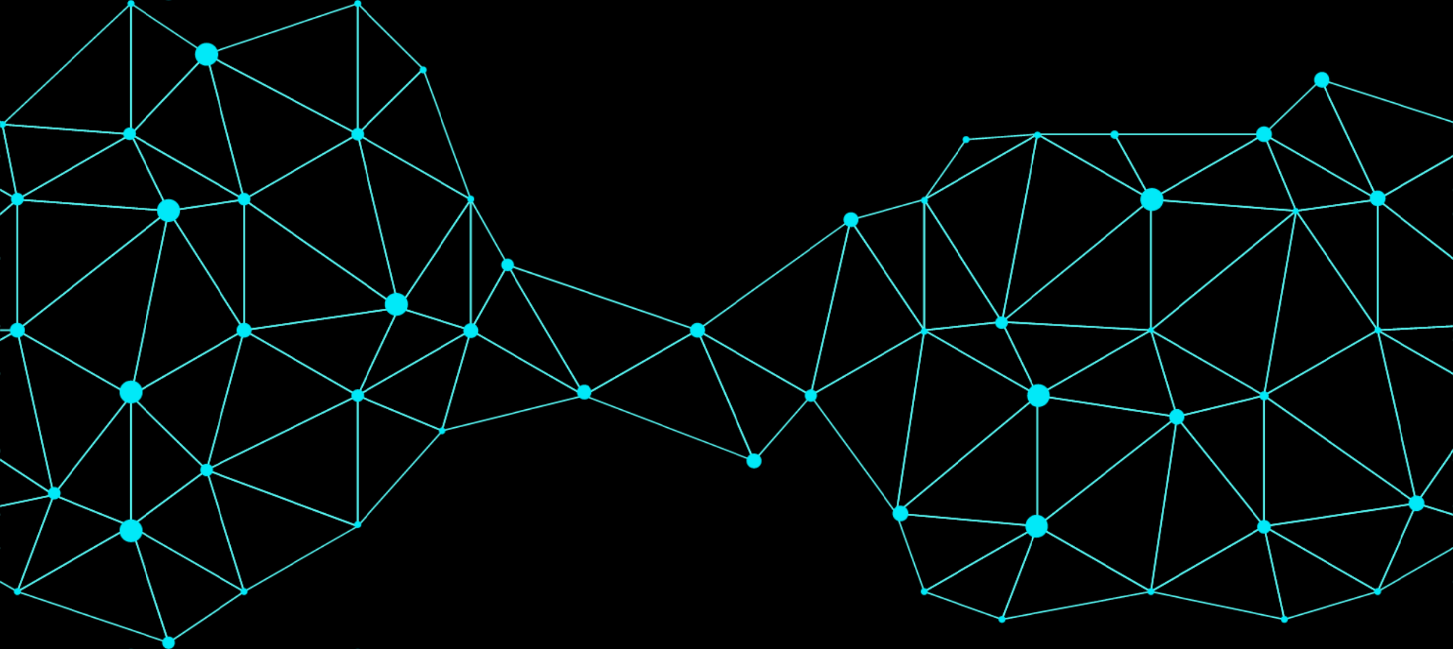
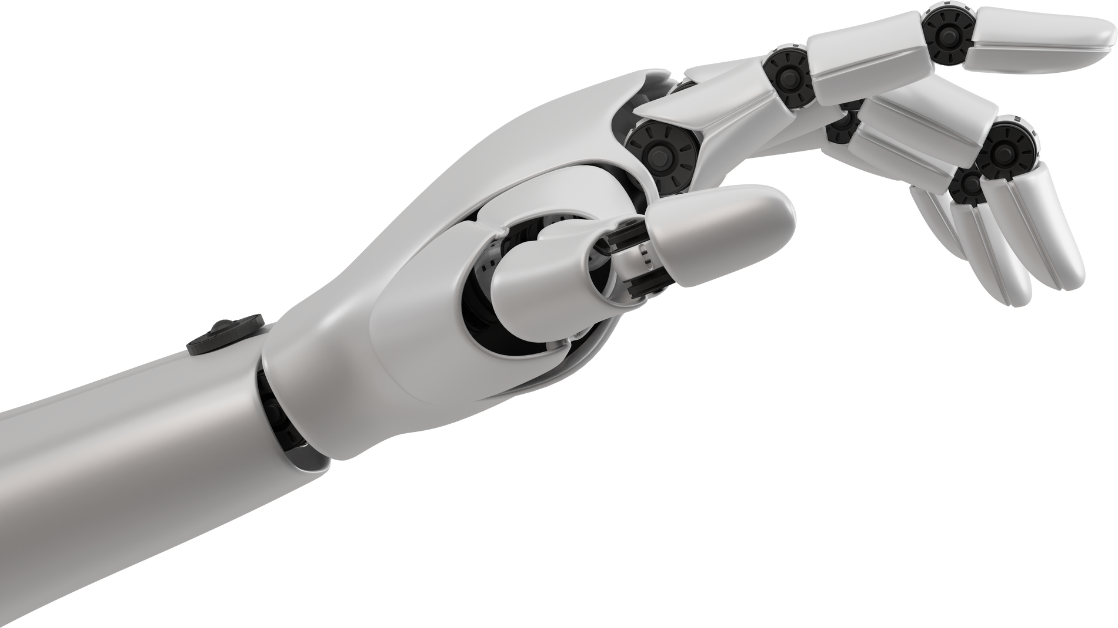
BIOSENSORS TRENDS
Cutting-Edge Research Trends
FUTURE TRAJECTORY
Technological Focus
Primary Research Domains
AI-integrated biosensing
Nanotechnology
Point-of-care diagnostics
Quantum detection mechanism
Personalized medicine
Real-time health monitoring
Non-invasive diagnostics
Environmental sensing
Future Trajectory
Precision healthcare technologies
Molecular-level detection capabilities
Miniaturized implantable devices
Adaptive intelligent sensing platforms

Slide 6
12 TOP-RATED BIONANOSENSORS AI MODEL DEVELOPMENT PROJECTS
01
02
03
08
Title: "AI-Enhanced Biosensors for Pathogen Detection"
Webiste: ResearchGate
Citations:120
Title: "Machine Learning Applications in Nano-Biosensing for Diabetes"
Website: MDPI
Citations: 115
Title: "AI for Predicting Protein Interactions Using Nanobiosensors"
Website: DeepGT@ sciencedirect
Citations: 138
Title: "AI-Optimized Nanobiosensors for Drug Delivery"
WebsitScience Direct
Citations: 108

Slide 7
12 TOP-RATED BIONANOSENSORS AI MODEL DEVELOPMENT PROJECTS
05
06
07
08
Title: "Nanopore Sequencing with AI for Biomarker Detection
Website: National Library of Medicine (NIH/NLM)
Citations: 152"
Title: "AI-Driven Nanobiosensors for Early Cancer Detection"
Website: SpringerLink
Citations: 145
Title: "Deep Learning for Nanoparticle-Based Biosensors"
Website: DeepGT@ sciencedirect
Citations: 138
Title: "Smart Sensors: AI Models for Detecting Neurotransmitters"
Website: MDPI
Citations: 129

Slide 8
12 TOP-RATED BIONANOSENSORS AI MODEL DEVELOPMENT PROJECTS
09
10
11
12
Title: "AI in Nano-Biosensing for Environmental Pollutants"
Website: UpGrad Science Direct
Citations: 105
Title: "AI-Driven Nanobiosensors for Real-Time Disease Monitoring".
Website: Eurasian Journal of Science and Technology
Machine learning-assisted calibration of Hg2+ sensors based on carbon nanotube field-effect transistors
Website: Science Direct
Title: "AI and Nanobiosensors for Personalized Medicine"
Website: Taylor & Francis

Slide 9
AI IN BIOSENSORS
AI IS REVOLUTIONIZING BIOSENSORS IN FOUR KEY WAYS:
ENHANCED SIGNAL PROCESSING
MULTIMODAL DATA FUSION
AI (especially deep learning) filters noise and extracts subtle patterns from complex biosensor signals, improving accuracy and reliability.
AI predicts future health events and detects diseases early by identifying subtle anomalies in biosensor readings.
PREDICTIVE MODELING
SMART AND ADAPTIVE BIOSENSORS
AI combines data from multiple biosensors and contextual information (e.g., patient history) for more holistic and personalized insights.
AI enables biosensors to autonomously adjust their operation based on real-time feedback, optimizing performance and reducing manual intervention.

Slide 10
TOP 5
BIONANOSENSOR GADGETS
of genome sequencing projects

Slide 11
OXFORD NANOPORE MINION
Description: A portable, USB-powered device that uses nanopore technology for DNA and RNA sequencing. It's known for its ability to provide real-time, long-read sequencing data, making it ideal for fieldwork or rapid diagnostics.
Projects: Used in various fields, including environmental sampling, infectious disease outbreak investigation, and even space research for monitoring microbes in the International Space Station.

Slide 12
ION TORRENT BY THERMO FISHER SCIENTIFIC (FORMERLY LIFE TECHNOLOGIES):
Description: Utilizes semiconductor sequencing technology to detect hydrogen ions released during DNA polymerization. This method is fast, capable of delivering results in hours, and does not require optical components.
Projects: Employed in clinical diagnostics, particularly for targeted sequencing panels, and was part of significant population-scale sequencing initiatives.

Slide 13
FENT (FIELD EFFECT NANOPORE TRANSISTOR) BY INANOBIO:
Description: A novel CMOS transistor-nanopore sensor designed for molecular sensing and biopolymer sequencing. It combines the benefits of CMOS technology with nanopore sequencing to provide high sensitivity and specificity.
Projects: Mentioned in contexts involving advanced biopolymer sequencing and molecular sensing, potentially impacting areas like drug development and personalized medicine.

Slide 14
GENAPSYS SEQUENCER:
Description: Uses complementary metal oxide semiconductor (CMOS) sequencing chips with millions of sensors for detecting minute electrical changes caused by nucleotide incorporation. It's designed for smaller sequencing projects but with high accuracy.
Projects: Applied in gene editing validation, targeted sequencing, and RNA sequencing, offering a compact solution for genomic applications.

Slide 15
SOPHIA GENETICS DDM (DATA DRIVEN MEDICINE) PLATFORM
Description: While not strictly a "sensor," the platform integrates AI with sequencing data from various devices, including bio-nanosensors, to analyze genetic mutations. It uses bioinformatics to enhance the interpretation of sequencing data.
Projects: Utilized in clinical settings for diagnosing cancer, metabolic disorders, and other genetic conditions, focusing on improving the accuracy and speed of genetic analysis through AI.

Slide 16
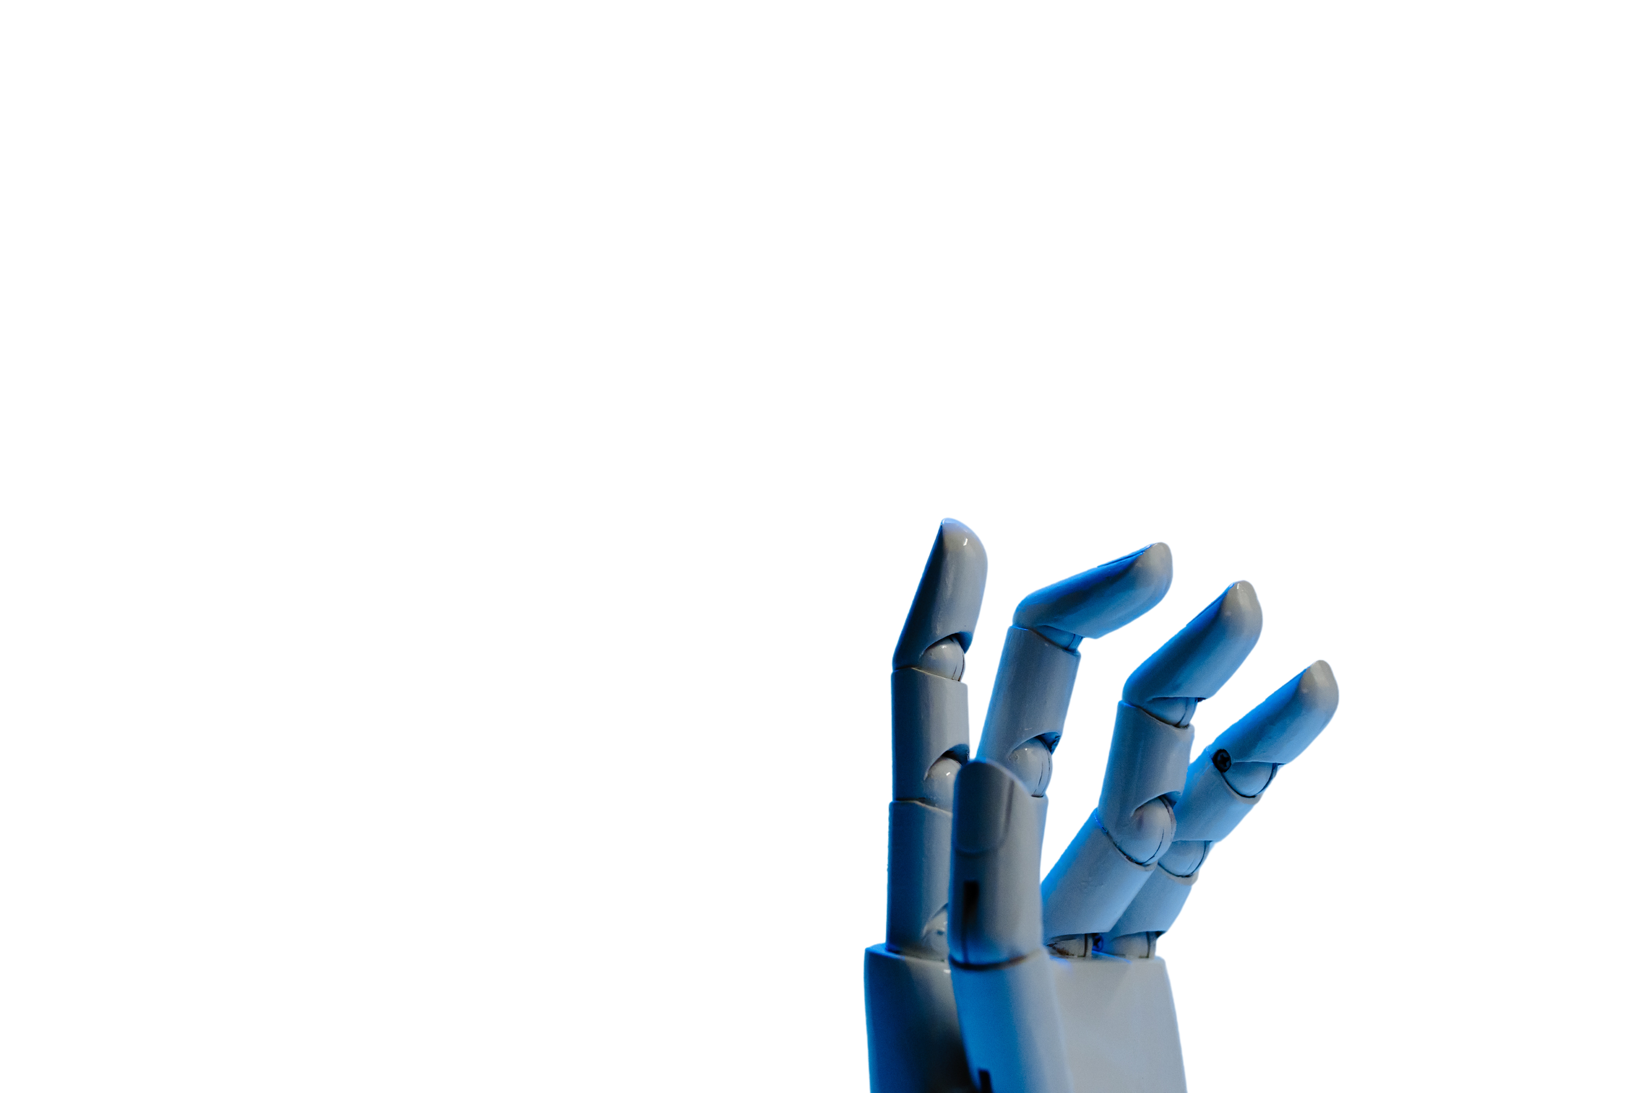
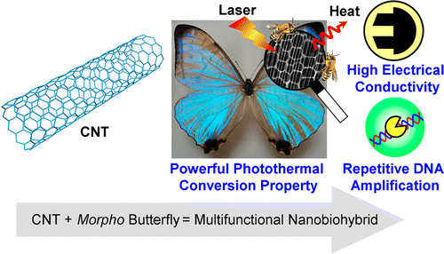
New INNOVATIONS
SOFT BIOELECTRONIC SENSOR IMPLANT CAN MONITOR SIGNALS IN THE DEVELOPING BRAIN
Soft bioelectronics demonstrated high-quality acquisition and processing of biological signals, suggesting applications far beyond their initial neurological focus. According to Chocaholic, these ion-gated transistors could replace bulky, non-biocompatible components in bioelectronic devices, transforming how medical technology interacts with the body.

Slide 17
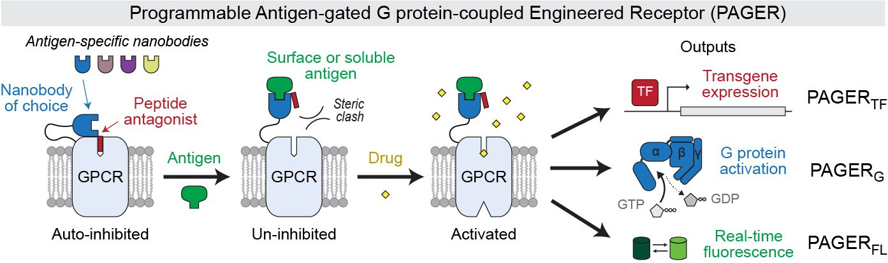
New INNOVATIONS
PAGER : PROGRAMMABLE ANTIGEN-GATED PROTEIN COOLED ENGINEERED RECEPTOR
PAGERs provide modular, customizable G-protein-coupled receptors for cell-signalling studies.
State-of-the-art in engineering small molecule biosensors and their applications in metabolic engineering

Slide 18
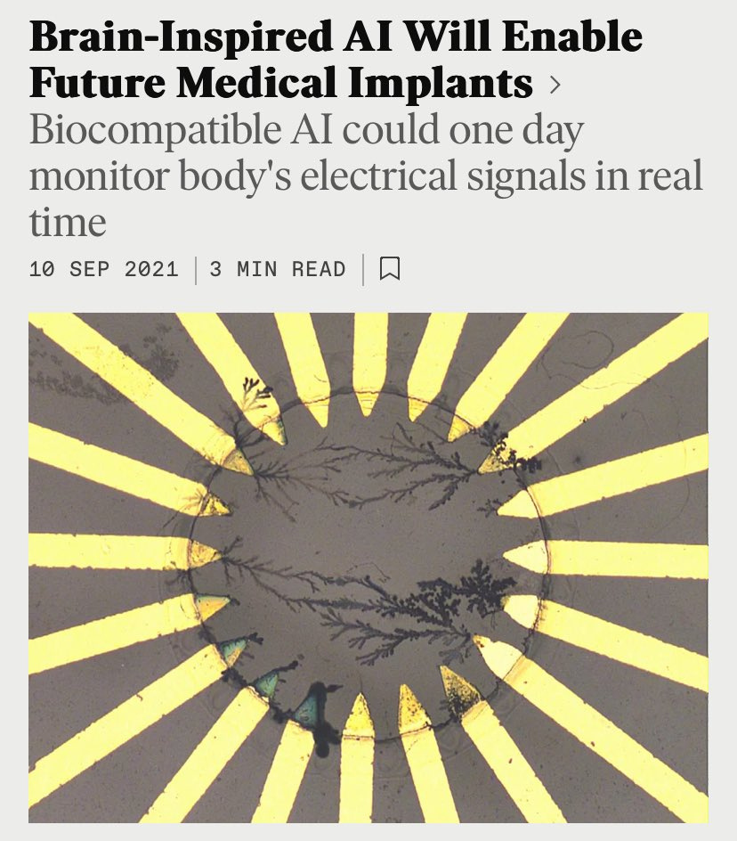
New INNOVATIONS
BRAIN-INSPIRED AI WILL ENABLE FUTURE MEDICAL IMPLANTS
"Biocompatibility AI" is a relatively new concept that explores how artificial intelligence (AI) can be used to assess, predict, and enhance the biocompatibility of materials and devices intended for use in biological systems.
A new biocompatible AI takes healthcare monitoring to the next level.
Most medical implants are dumb, but by creating the world’s first biocompatible AI researchers are literally putting a doctor inside your body.

Slide 19
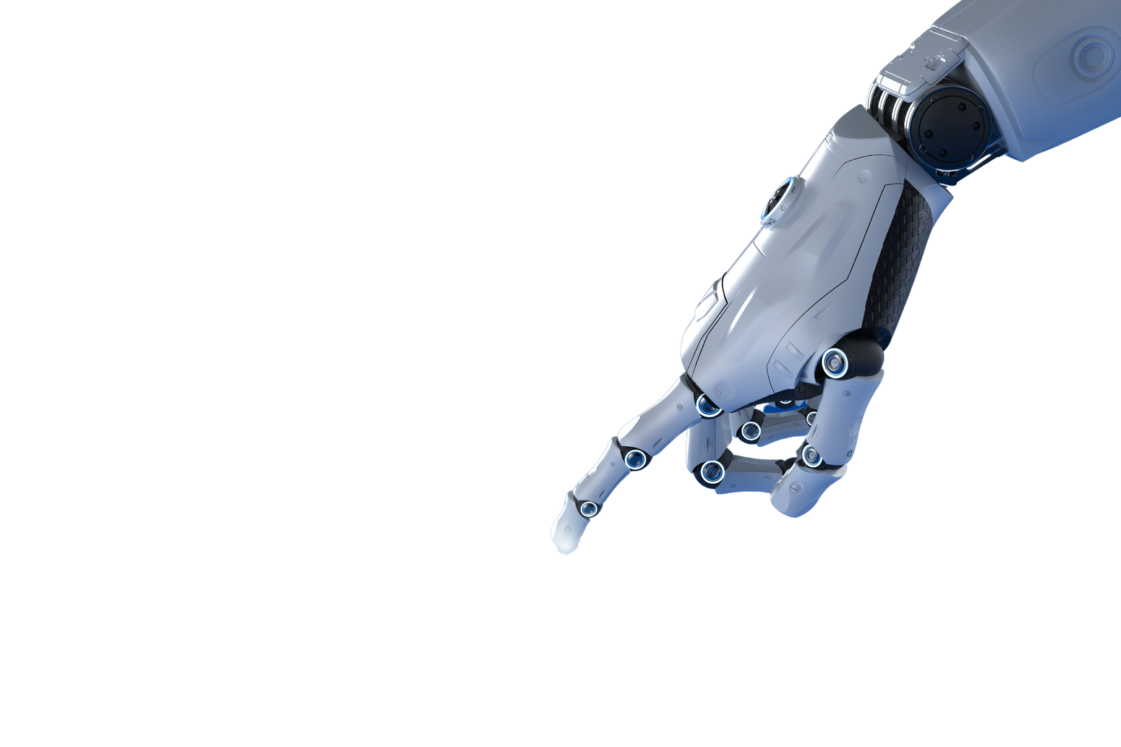
RESULTS AND ACHIEVEMENTS
AI has significantly advanced biosensor technology, leading to impressive results and achievements across various applications. Here are some key highlights:
Enhanced Diagnostic Accuracy and Sensitivity:
01
Advanced Signal Processing and Data Analysis:
02

Slide 20
THANK YOU!

